Slide 1
From Oil Tankers to Speedboats
Agility & DevOps at Scale
Jonathan Smart @jonsmart June 2016

Slide 2
Context
Notes:
First, some context

Slide 3


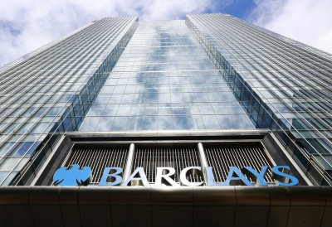
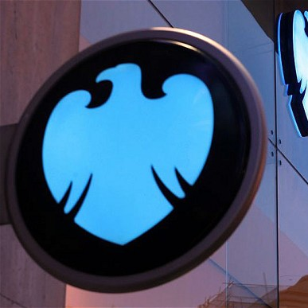
Barclays moves, lends, invests and protects money for customers and clients worldwide
325 years old
Founded 1690
Four years before the Bank of England
130,000 employees in 40 countries
Personal banking, credit cards, corporate and investment banking and wealth management
48m customers
Notes:
Barclays is a transatlantic consumer, corporate and investment bank offering products and services across personal, corporate and investment banking, credit cards and wealth management, with a strong presence in our two home markets of the UK and the US.
With over 325 years of history and expertise in banking, Barclays operates in over 40 countries and employs approximately 130,000 people. Barclays moves, lends, invests and protects money for customers and clients worldwide.

Slide 4

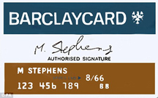
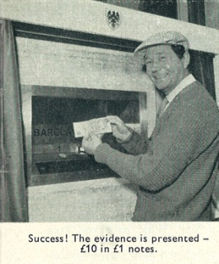
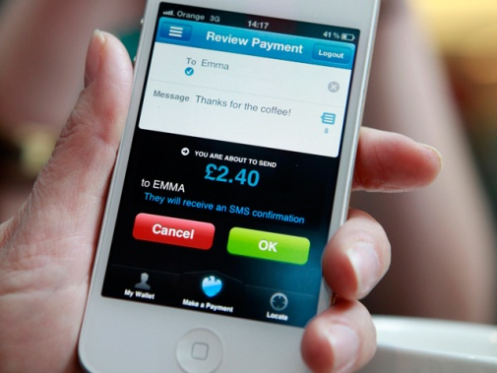
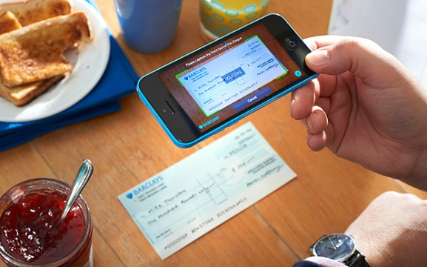
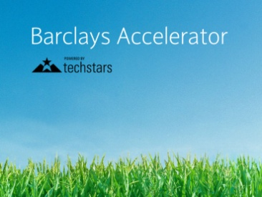

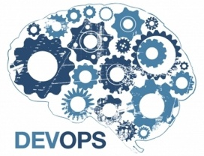
A history of innovation
First female bank manager
First credit card (outside US)
First cash machine
First mobile payments transfer
First mobile cheque imaging
Barclays Accelerator
Blockchain smart contracts
Embracing Agile & DevOps
Notes:
First female bank manager in 1958
Launched first credit card outside of the USA (1966, Barclaycard)
Launched first cash machine in the world in London in 1967
First public demonstration and first announcement of smart contracts for OTC derivatives using R3’s Corda platform
http://marketsmedia.com/blockchain-comes-out-of-the-lab/

Slide 5
Mission Critical
Barclays processes payments worth 30% of the UK GDP every single day
~£600 billion a day
£220 trillion per annum

Slide 6
Highly Regulated
222 Financial Regulatory Authorities globally¹
Financial Services is the most regulated industry²
Hundreds of internal standards
Waterfall Lifecycle, 7 gates, 28 artefacts
Source: Wikipedia
Source: The McLaughlin-Sherouse List: The Top 10 Most Regulated Industries in 2014 (Depository and Non-depository)
Notes:
We have been waterfall. Inefficient. Everything at the end.

Slide 7
Why Agility?
A better way of working
Risk  Quality  Concept to Cash time 
Delight customers and engage colleagues
Disruptive innovation and new entrants
Survival of the ...?
Notes:
Delighted customers & colleagues
leads to increased returns
Copernican Revolution
Survival of the most adaptable

Slide 8

Agility at Scale
Notes:
We’ve been adopting agility at scale since Jan 2015
As far as we know the largest agile transformation in the world
Will share lessons learnt in the first 15 months
How can we do this with this level of complexity and regulation?
Teaching elephants to dance.
Is agility for horses as well as unicorns?

Slide 9
Agility = Agile + DevOps
Notes:
First, a definition.

Slide 10

My charter
Servant Leader on agility across Barclays
Barclays UK
Personal Banking
UK Cards
Wealth, Entrepreneurs & Business Banking
Barclays Corporate & International
Corporate and Investment Bank
Consumer, Cards and Payments
Barclaycard & Wealth International
Holistic Agility (incl. Audit, HR, Finance, Real Estate, etc.)

Slide 11
How are we doing after 16 months?
From 4% to more than 50% of spend on strategic change being spent with agile practices
800+ additional teams now working with agile practices (approx. 10,000 people)
30,000 training attendances
As far as we know, the world’s fastest and largest agility adoption

Slide 12
How are we doing after 16 months?
56% of apps deploy every 0-4 weeks
Notes:
+2 every week

Slide 13
How are we doing after 16 months?
56% of apps deploy every 0-4 weeks
Lead Time 

Slide 14
How are we doing after 15 months?
56% of apps deploy every 0-4 weeks
Lead Time 

Slide 15
How are we doing after 16 months?
56% of apps deploy every 0-4 weeks
Lead Time 
Quality 

Slide 16
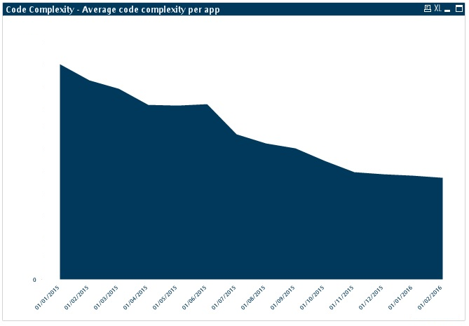
How are we doing after 15 months?
Code Complexity average per app (n=87)
56% of apps deploy every 0-4 weeks
Lead Time 
Quality 
50% reduction
Jan ’15 Feb ‘16

Slide 17
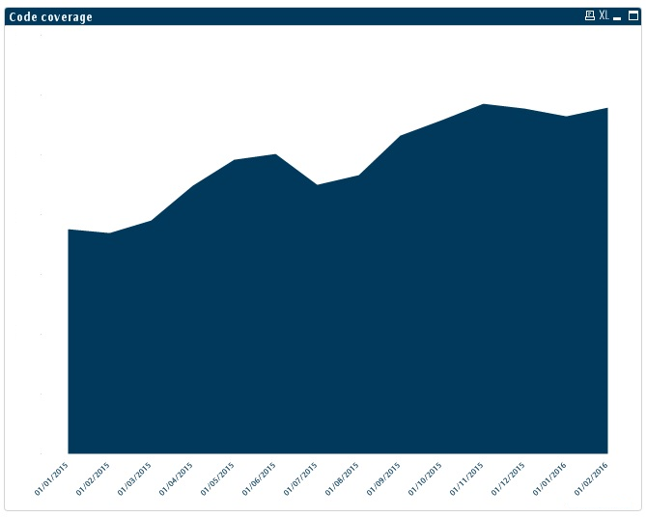
How are we doing after 15 months?
Test Code Coverage average per app (n=50)
56% of apps deploy every 0-4 weeks
Lead Time 
Quality 
50% increase
Jan ’15 Feb ‘16

Slide 18
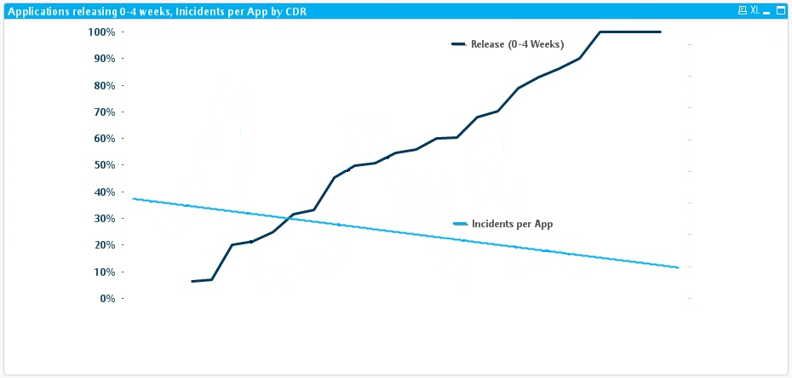
How are we doing after 15 months?
⬆Release Cadence = ⬇Incidents
% apps deploying 0-4 weeks
Incidents per app (average)
56% of apps deploy every 0-4 weeks
Lead Time 
Quality 
Business Area 1 ..... Business Area N

Slide 19
How are we doing after 16 months?
56% of apps deploy every 0-4 weeks
Lead Time 
Quality 
Satisfaction 

Slide 20
How are we doing after 15 months?
NPS score +21
7-10 = 79%
56% of apps deploy every 0-4 weeks
Lead Time 
Quality 
Satisfaction 
How much would you recommend an agile way of working to a colleague?
(864 respondents)

Slide 21
How are we doing after 16 months?
Example: Derivatives system
Testing duration  (8 days to 20 mins, 192x faster)
Release frequency  (7 to 70 times per month)
Quality  (zero recent production incidents)
First to clear $1 trillion in OTC Clearing notional

Slide 22
How are we doing after 16 months?
A great start
You don’t have to be a unicorn
Lasting culture change takes years
We still have lots to do
What are our lessons learnt so far?
Notes:
A great start...
However, it takes many years for culture change to embed
It’s hard
26% of execs reported successful enterprise transformations

Slide 23
Culture
is huge

Slide 24

Aiki...
...is to pull when you are pushed
to push when you are pulled
It is the spirit of slowness and speed
of harmonizing your movement
with your opponent
Notes:
Aiki is a Japanese martial arts principle or tactic in which the defender blends (without clashing) with the attacker, then goes on to dominate the assailant through the strength of their application of internal dynamics or Ki energy to affect techniques. Blending with an attacker's movements allows the Aiki practitioner to control the actions of the attacker with minimal effort. One applies aiki by understanding the rhythm and intent of the attacker to find the optimal position and timing to apply a counter-technique.
In Japanese Aiki is formed from two kanji:
合 - ai - joining
氣 - ki - spirit

Slide 25
Blending not clashing
Use of Internal Strength
Leading the assailant

Slide 26
One Size Does Not Fit All

Slide 27
Scaling
Don’t scale agile: Descale the work first
Enterprise Scaling is Breadth, Diversity and Complexity
Shu Ha Ri
Product : Team cardinality 1:1 1:M M:M M:1
10s, 100s, 1000s, 10000s, 100000s people

Slide 28
Practices = Principles + Context

Slide 29
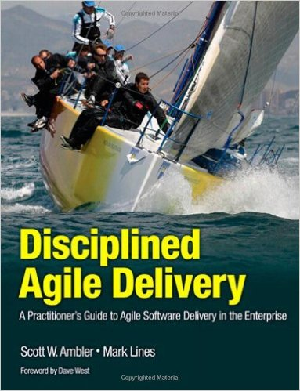
3 Common Scaling Frameworks
Disciplined Agile
SAFe
LeSS
Our overarching approach is based on DA as a goal based, enterprise aware, not one size fits all, risk & value, framework, suitable for enterprise scaling

Slide 30
One Size Does Fit All

Slide 31

Why
Principles
Change Lifecycle
Roles
Targets

Slide 32
Blending not clashing
Use of Internal Strength
Leading the assailant

Slide 33
Top Down and Bottom Up

Slide 34
Communities of Practice

Slide 35
Champion Network
Notes:
With Autonomy, Purpose and Mastery
Mention Federation and Divide and Conquer

Slide 36
Story Telling
Notes:
McKinsey survey.
Communication contributes the most to a transformation’s success.
12x more likely to be successful when managers communicate continually
http://www.mckinsey.com/business-functions/organization/our-insights/how-to-beat-the-transformation-odds#0
While the results show that success links closely to a greater overall number of actions, they also indicate that not all 24 actions are created equal. Communication, specifically, contributes the most to a transformation’s success (Exhibit 2). At companies where senior managers communicate openly and across the organization about the transformation’s progress, respondents are 8.0 times as likely to report a successful transformation as those who say this communication doesn’t happen. Good communication has an even greater effect at enterprise-wide transformations, where company-wide change efforts are 12.4 times more likely to be successful when senior managers communicate continually.
When asked what they would do differently if the transformation happened again, nearly half of respondents (and the largest share) wish their organizations had spent more time communicating a change story.

Slide 37
Training and Coaching

Slide 38
Leadership Training

Slide 39
Leadership at all levels Autonomy, Purpose and Mastery

Slide 40

Technical Excellence
Agile Architecture
Agile HR
Agile Portfolio Management
Working Environment

Slide 41

DevOps at Scale
DevOps Leadership Forum
Federated, not centralised, not decentralised
DevOps Champions
DevOps is not a role
DevOps is a practice, it can’t be purchased

Slide 42
Blending not clashing
Use of Internal Strength
Leading the assailant

Slide 43
In large enterprises Dev+Ops is not enough – it has to be “Holistic Agility”
BizFinancePMOHRLegalComplianceAuditDevSecOps
is needed for Business Agility
Otherwise Impedance Mismatch
Holistic Feature Teams

Slide 44


Agility and Control
Control Tribes
Control Tool

Slide 45
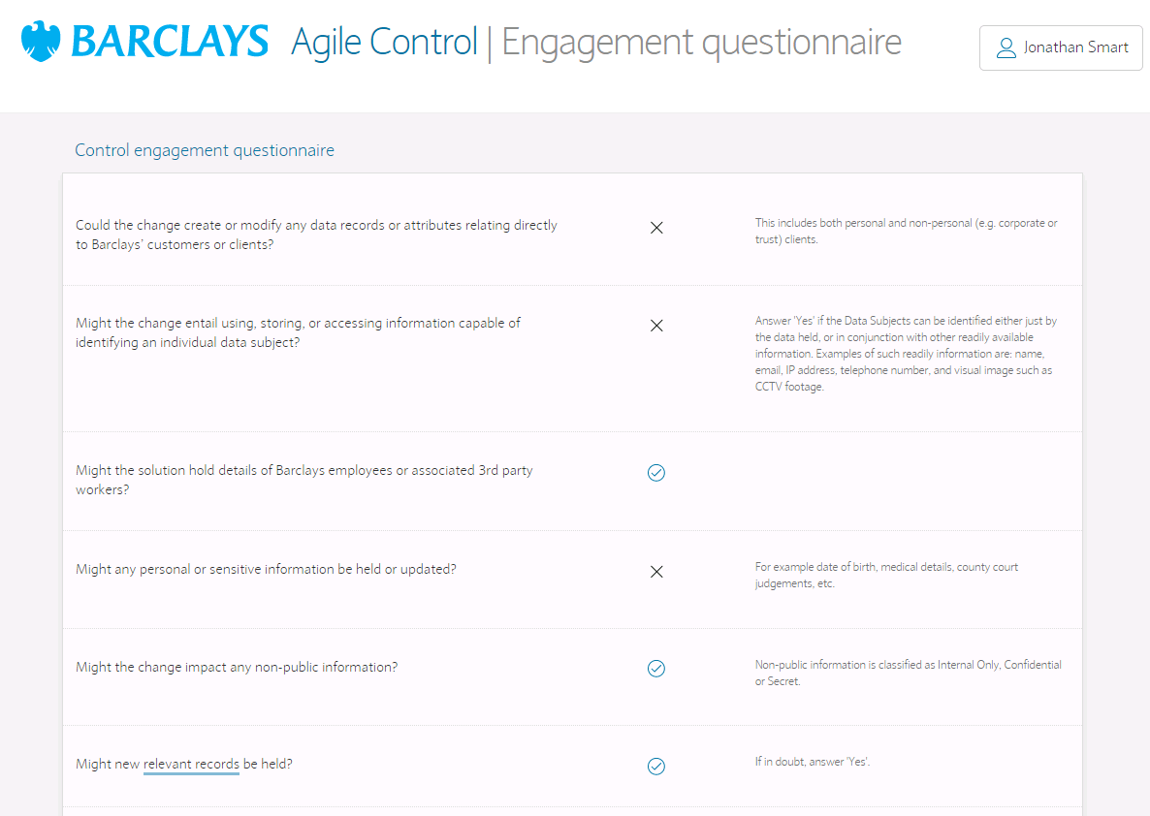
Agile Control Tool
Assigns Epic to Control Tribe, emphasis on early and often conversation
Lean process. From 7 control points to 2
One place for everything
20 questions, not hundreds
From 58 days elapsed to 1 day elapsed

Slide 46
Agility Levels
Agility Level | Description | Agility Criteria
Level 1 | Mobilising | Largely Cross functional Team …
Level 2 | Transitioning | Daily Coordination Meeting Regular Show and Tell …
Level 3 | Established | WIP limited Lead Time reduced Technical Excellence ...
Level 4 | Optimising | Teams optimising their practices Lead Time further reduced Holistic Business Agility …
Notes:
Levels
Self assessment
*Targets*
Management, not team level
Not low, not high
Relative ranking

Slide 47
... allows us to forecast and measure
Notes:
Need a target to be able to plan ahead. Destination.
Allows us to plan the journey.
*Don’t make the targets the reason Why*

Slide 48
Aiki…
Blending not clashing
One size does not fit all
Use of Internal Strength
Champions, Leadership, Communication
Leading the assailant
Agility Levels, Holistic

Slide 49
The forward path...
From Business & Technology to Product
Holistic Business Agility
Interconnected Ecosystems
Evolutionary Revolution
Experimental Revolution
Continual and sustainable change is a competence

Slide 50
Here’s some areas we would welcome input
In a highly regulated environment:
Information security & public cloud
Containers at scale
auditability, debugability, traceability
SOX & Dev access to Production
Any stories of holistic agility at scale!

Slide 51
Thank You
@jonsmart

Slide 52
[ ]
Most Regulated Industries
Source: The McLaughlin-Sherouse List: The Most Regulated Industries in 2014

Slide 53

Dealing with Agile & Waterfall
Start with the natural champions
Move the cheese
Leadership
Show the waterfall team, it may be infectious
Internal Open Source
Feature Toggles
Stubbing and Mocking
Bimodal is not OK!

